Slide 1
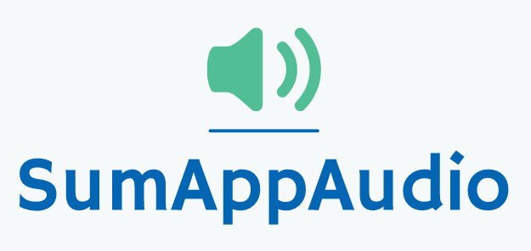
Fifth checkpoint
Group 4
Marco Carfora
Daniele Calisi
Francesco Bovi

Slide 2



Dyslexic students problems
During the last years the awareness on the dyslexia is increased. Indeed, it has been registered a raise of students with certified dyslexia (250.000 cases in Italy); from 0.7% in 2010 to 3.2% in 2018, on the total number of students.
Difficulties in reading and comprehending text
Don’t have a way to easily grasp the concepts, making the learning slow
Struggle to autonomously review school subjects

Slide 3



A student-to-student solution
Sum-AppAudio is a digital platform based on a student-to-student model to support the study of students with dyslexia. The core of the App are the recorded files that every student can upload to summarise subject topics or book chapters.
Uploads recordings
Listens recordings
NON-DYSLEXIC STUDENT
Gives feedbacks
DYSLEXIC STUDENT
Certifies recordings
TUTOR

Slide 4
Customers and Market size
Dyslexic students in Italy:
2% of primary schools students = 56.000; 5.6% of middle schools students = 90.000; 4.7% of high schools students = 122.000;
Non dyslexic students in Italy
Schools and pedagogical associations
Support teachers/tutors
Students in the world
TAM
3 Bln €
SAM
0.8% of TAM
Students in Italy
SOM
1,7% of SAM
Students in Rome (middle and high school) with a dyslexic in class
EARLY ADOPTERS

Slide 5

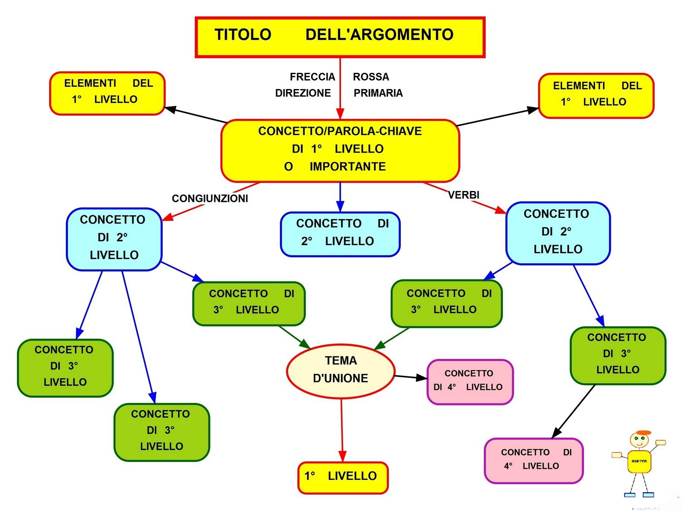




COMPETITORS ANALYSIS
Student-to-student system
Concept maps
Ad hoc Textbooks
Voice synthesizers
Ad hoc audio for dyslexic students

Slide 6
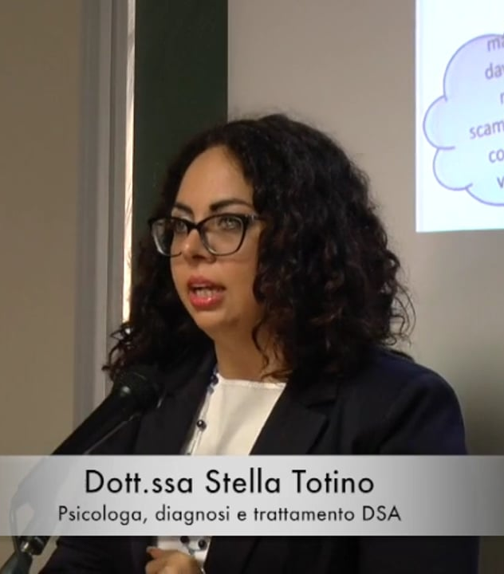

Expert Opinion (1/3)
Stella Totino
Pierluigi Zoccolotti
Psychologist;
Psychotherapist;
Neurodevelopmental disorders, in particular DSA, ADHD, language disorders and study method.
Diagnosis of affective and relational disorders associated with DSA (University of Urbino Carlo Bo).
Psychologist;
Member of the Editorial board of “Annals of Dyslexia”;
Member of the scientific group of Fondazione Italiana Dislessia;
Director of PhD in “Disturbi dell’apprendimento e dello sviluppo cognitivo”;
Professor in La Sapienza University.

Slide 7
Expert Opinion (2/3)
“I think that making audio summaries can certainly be a useful aid for university students with specific learning difficulties.
In my opinion, the presence of aids should never completely replace exercise and, where possible, targeted rehabilitation interventions, but certainly the availability of well-made audio summaries can represent a positive element in the study, especially for children with reading difficulties.”
Pierluigi Zoccolotti

Slide 8


Expert Opinion (3/3)
-“The App can be useful for every DSA student, for example dysorthographia;”
-“In a lot of cases, the audio channel alone is not enough for an easy comprehension; therefore the App should include also a sort of visual channel: concept map and written text; “
-“The App should offer the possibility to parse the text shown with a voice synthesizer.”
-“The App should use a specific font useful for DSA students (EasyReading);”
Stella Totino
-
<

Slide 9
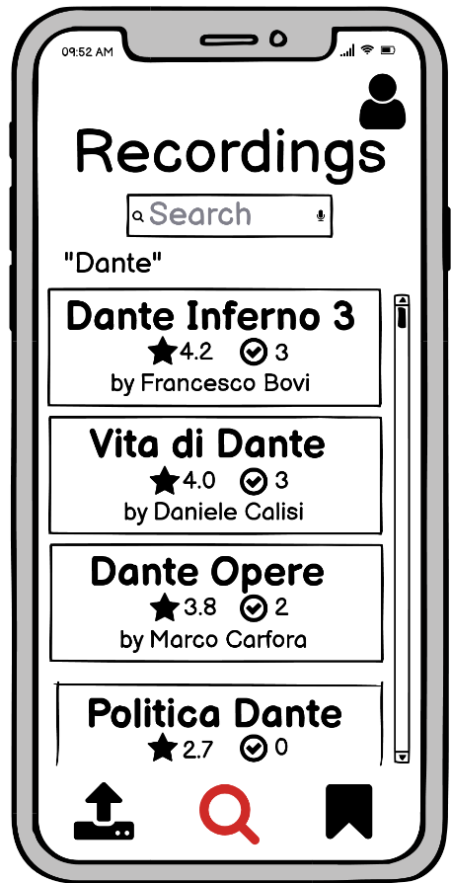
Recordings search Mockup
Current
Search
“EasyReading”
text font
Big
titles
Tutor Certifications
Holding down any title, the user can reproduce it with a voice synthesizer
Students Rating

Slide 10
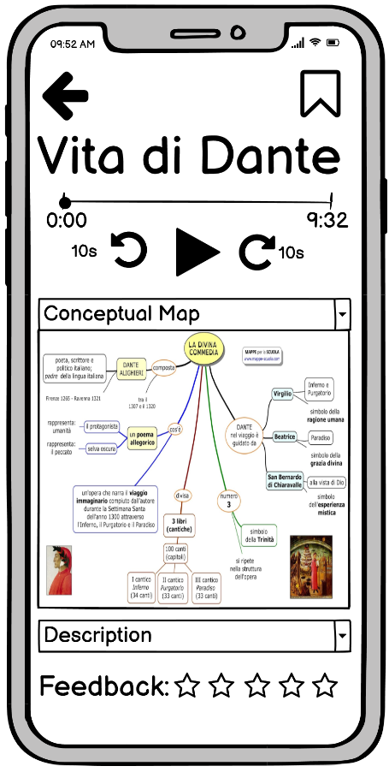


Recording details
Mockup
Concept Map
Playback managing
Description
Concept maps and descriptions aren’t optional: the user can upload them manually ( ), otherwise they are obtained automatically ( ).
Student Feedback

Slide 11
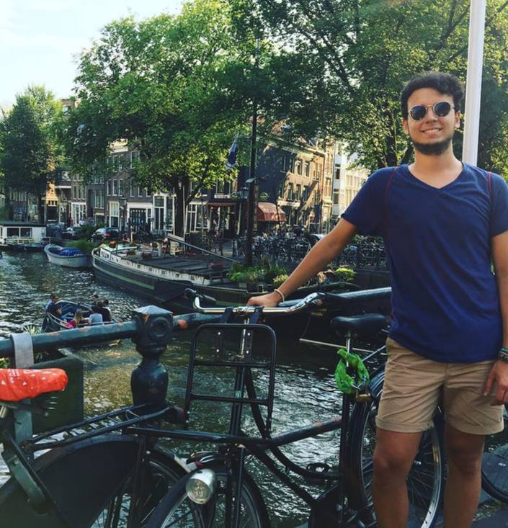

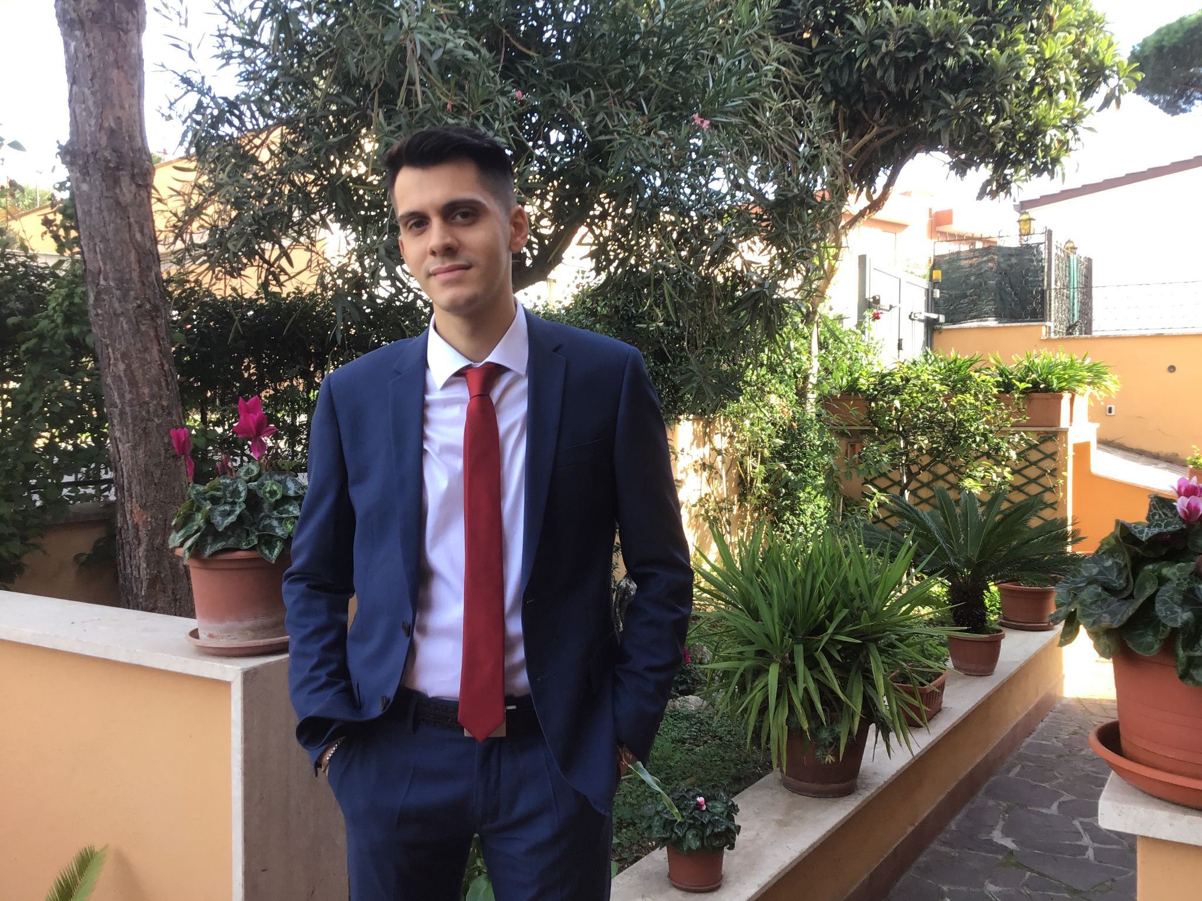
Our Team
MARCO CARFORA
DANIELE CALISI
FRANCESCO BOVI
Web design frontend
Mobile developer
Neural networks
Web design backend
Data management
Machine Learning experience
Software Developer;
Cybersecurity;
AI experience;

Slide 12
THANK
YOU!

Slide 13
Business concept
During the last years the awareness on the dyslexia is increased. Indeed, it has been registered a raise of students with certified dyslexia (177.000 cases in Italy), from 0.7% in 2010 to 3.2% in 2018 but the number is probably higher.
Students affected by dyslexia have difficulties in reading a text and troubles copying from the blackboard. They don’t have a way to easily grasp the concepts and to make the comprehension faster, indeed they usually need external help, like a tutor.
Sum-AppAudio is a digital platform based on a student-to-student model to support the study of students with dyslexia. The core of the App are the recorded files that every student can upload to summarise subject topics or book chapters. The system is designed ad hoc to overcome the difficulties that students with dyslexia have to face but also other students can enjoy the service.

Slide 14
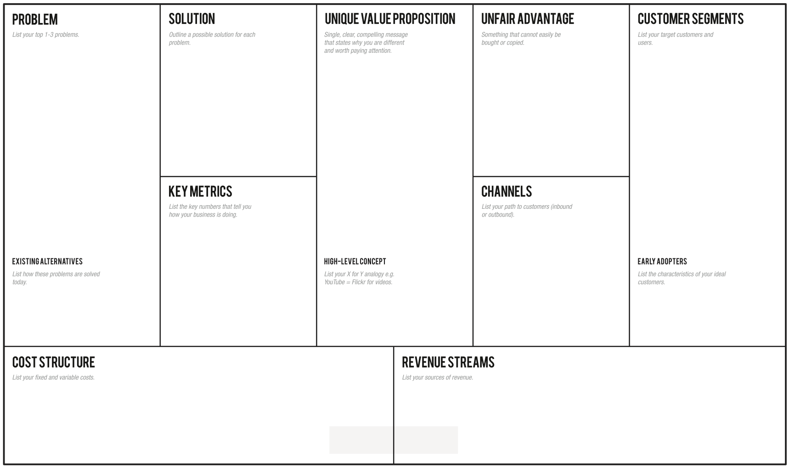
-Students with dyslexia have difficulties in reading and comprehending a text:
-They don’t have a way to easily grasp the concepts, making the learning slow.
-They need an easy way to autonomously review school subjects, indeed they usually ask for external help
Through the app the students can learn in an easier and efficient way, avoiding tiring readings, relying on recordings from a huge collection built thanks to a lot of students' support
Overcome your reading and learning difficulties, enjoy a student-to-student model whose core are the recorded files that every student can upload to summarise subject topics or book chapters for students with dyslexia.
-Students with dyslexia problems (2% from primary schools, 5.6% from middle schools, 4.7% from high schools).
-Schools and pedagogical associations -Support teachers.
-Every student who wants to help other ones.
-Number of produced and listened recordings (monthly).
-Content quality trends thanks to feedback system.
-How many results appear for a single topic.
-How many people use the app regularly (rate of accesses)
-Flyers distribution in front of selected schools and associations of this sector.
-A social page dealing with dyslexia problem.
-Meetings in school where we present our project to students.
- Selected classes with a dyslexic student in Rome schools, so classmates can help each other -Tutors / Support teachers
Skuola.net, ad hoc textbooks, Youtube, voice synthesizers, tutors, concept maps
Sum-AppAudio = Spotify for school summaries.
-Server/database maintenance;
-Channels’ cost;
-Gift cards at a later time
- Banner advertisements;
- Freemium App
- Partnerships with schools/associations;
- Partnerships with publishing companies to certify their content;

